Slide 1

College Search & Review Website
Our robust college search and review platform empowers students to make informed decisions about their higher education journey. With comprehensive college profiles, personalized search tools, and insightful reviews, we help you find the perfect fit.

Slide 2
Our Objectives
1
Advanced Search Filters
2
Personalized Profiles
3
Comprehensive College Profiles
Provide an intuitive and efficient college search experience, allowing students to easily find and compare institutions that match their unique needs and preferences.
Offer in-depth college profiles showcasing key details such as academics, campus life, cost, and student outcomes to support well-informed decisions.
Detailed profiles for each college or university will include information on admission requirements, tuition fees, campus amenities, faculty qualifications, and alumni statistics.
4
Reviews and Ratings
Empower students to learn from the experiences of their peers through a comprehensive review system, fostering transparency and confidence in the college selection process.

Slide 3
Hardware and Software Requirement Specifications
Hardware Requirements
Frontend Software Requirement
Backend Software Requirement
Intel Core i3 processor or equivalent, 4GB RAM or higher, and a screen resolution of 1366x768 pixels or higher.
React.js
Spring Boot
JavaScript (ES7+)
Java
CSS
Spring Framework
Frontend Libraries
RESTful APIs
Cloud Management
Database Management
AWS
MySQL

Slide 4

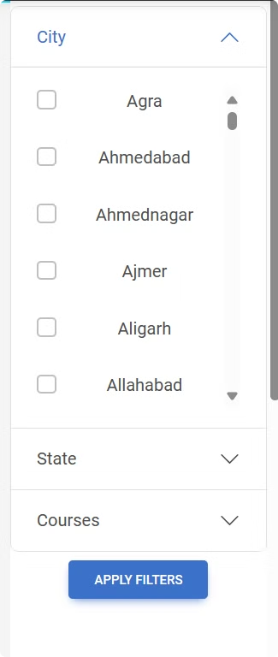
Comprehensive College Search
1
Filters
Narrow your search by city, state, program course, and other key criteria to find the perfect college match.
2
Comparisons
Compare colleges side-by-side to evaluate factors like tuition, acceptance rates, and student life.

Slide 5
Detailed College Profiles
Academics
Campus Life
Explore program offerings, faculty expertise, and academic resources to find the right educational fit.
Discover vibrant student communities, extracurricular activities, and campus amenities that foster personal growth.
Student Outcomes
Cost & Aid
Review key metrics like college, college facilities and job placement to gauge long-term success.
Understand tuition, fees, and financial aid options to make an informed decision about the investment in your education.

Slide 6

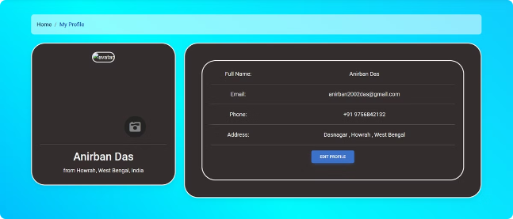


Personalized User Profiles
Review & Ratings
Edit Profile & Picture
Share your experiences and insights to help guide future students.
Edit their profile for their need and also can change their profile photo.

Slide 7





Trusted Student Reviews
Write Reviews
Students can share their firsthand experiences and insights about colleges they've attended.
Ratings & Feedback
Users can rate various aspects of a college, from academics to campus life, to help others make informed decisions.
Helpful Discussions
The review platform fosters conversations where students can ask questions and offer valuable advice.

Slide 8
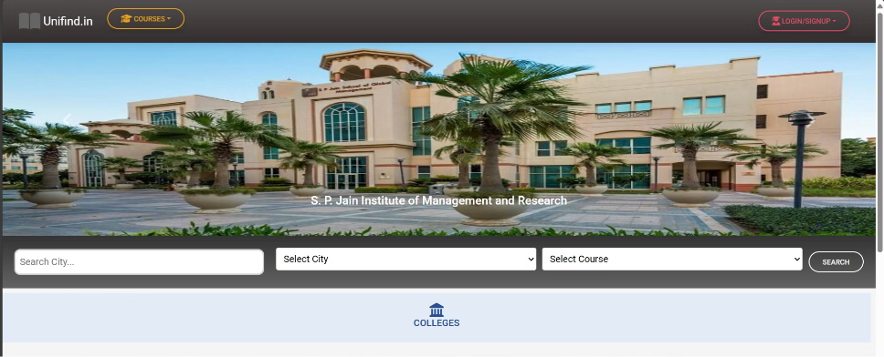
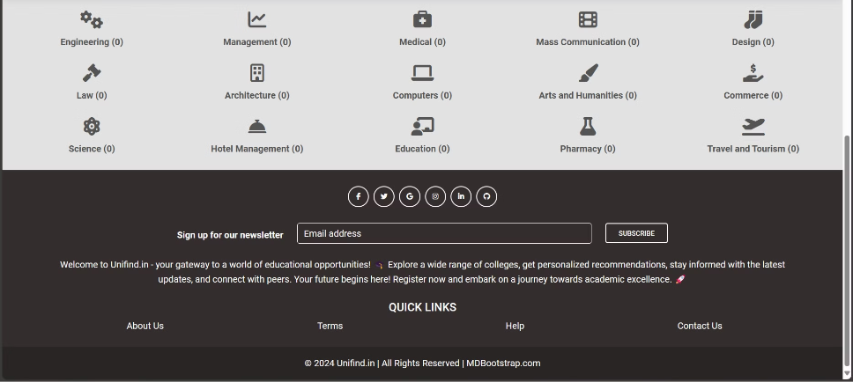
Website UI

Slide 9
Future Scope of Enhancement
Admission Predictor
Exam System
Develop an admission predictor tool based on historical admission data, test scores, GPA, extracurricular activities, etc.
Create a practice exam system for standardized tests like SAT, ACT, GRE, etc., allowing students to gauge their readiness.
Provide users with an estimate of their chances of admission to specific colleges based on their profile information.
Offer detailed feedback on performance, areas for improvement, and access to study resources.
Provide personalized study plans or recommendations based on exam results to aid in preparation.

